Slide 1
#8314 Auto generation of Source lines of code
PRS report generation.
Notes:
Talking points:
We have built QuEST over the last 21 years as a aspiration driven organization. We continue to push the boundaries, create new frontiers across multiple safety critical and hi-tech industries we serve. We do this by offering our Customers a range of Services and Solutions and engagement models that spans – Engineering, Enterprise solutions, Operations, Supply Chain and Technology enabled solutions covering the complete product lifecycle.
As such, QuEST is a Leading Global Product Engineering and Lifecycle Services Company
In this presentation we will cover 3 aspects of QuEST.
WHO we are, WHAT we do and for WHOM, and why we are in business – our purpose
Then we move on to HOW we engage with Customers
Finally we will cover HOW we are different and can add unique value to you and help you “Create the Frontier”

Slide 2
Template & Guidelines – Productivity Tool
QuEST PRODUCTIVITY TOOL
Productivity Tool Title^{#1: #}8314 Auto generation of Source lines of code (KLOC Counter)
Author(s)^{#02}: Vinoth N | Email^{#03} : Vinoth.n1@quest-global.com | Date ^{#04}: 15-08-2021
Objective^{#05} : To automate the calculation of lines of code (LOC) and the creation of program remodeling specification document (PRS).
Summary^{#06}: We provide the customer with a program remodeling specification document as part of the official release. This includes information about the source code, such as the file name, path, function names, LOC count based on functions, and so on. Generally, developers open each source file and manually count the lines of code before creating the PRS document. It takes a long time, and verification takes the same amount of time. We are now improving the process by creating this tool. This tool helps in the automation of the LOC count and document creation. Normally, the LOC counting process takes more than three working days. We can now count in minutes.
Revision | Description | Date
01 | Initial release | 23-08-2019
02 | Adding defect monitor | 07-11-2019
03 | Support custom PRS template | 14-09-2020

Slide 3
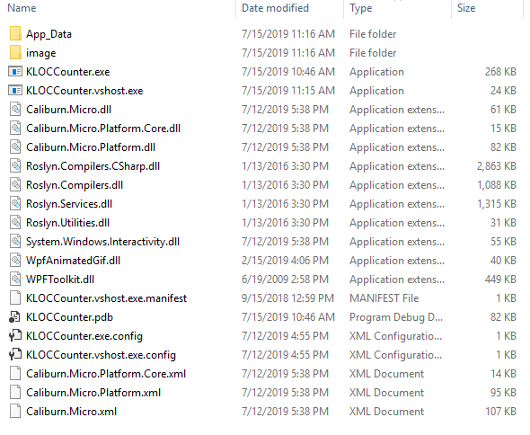
How to use Productivity tool?
Get the KLOCCounter.zip by double clicking the attachment.
Screenshot represents the folder after the zip extraction.
Run the KLOCCounter.exe file after extracting the KLOCCounter.zip file into the specified folder.
Note:
It is a Windows program. As a result, it is only compatible with the Windows operating system.
Using these tools, we can create a PRS document. The PRS document is an excel spreadsheet. As a result, we must have MS Excel installed and activated on our system.

Slide 4
Substantiation of Productivity tool
Get the PRS report.xls by double clicking the attachment.
KLOC Counter is a tool for counting lines of code (LOC). It aids in the examination of source files and displays information. This tool used to generate program remodeling specification document.
Attached sample PRS report above for more reference.

Slide 5
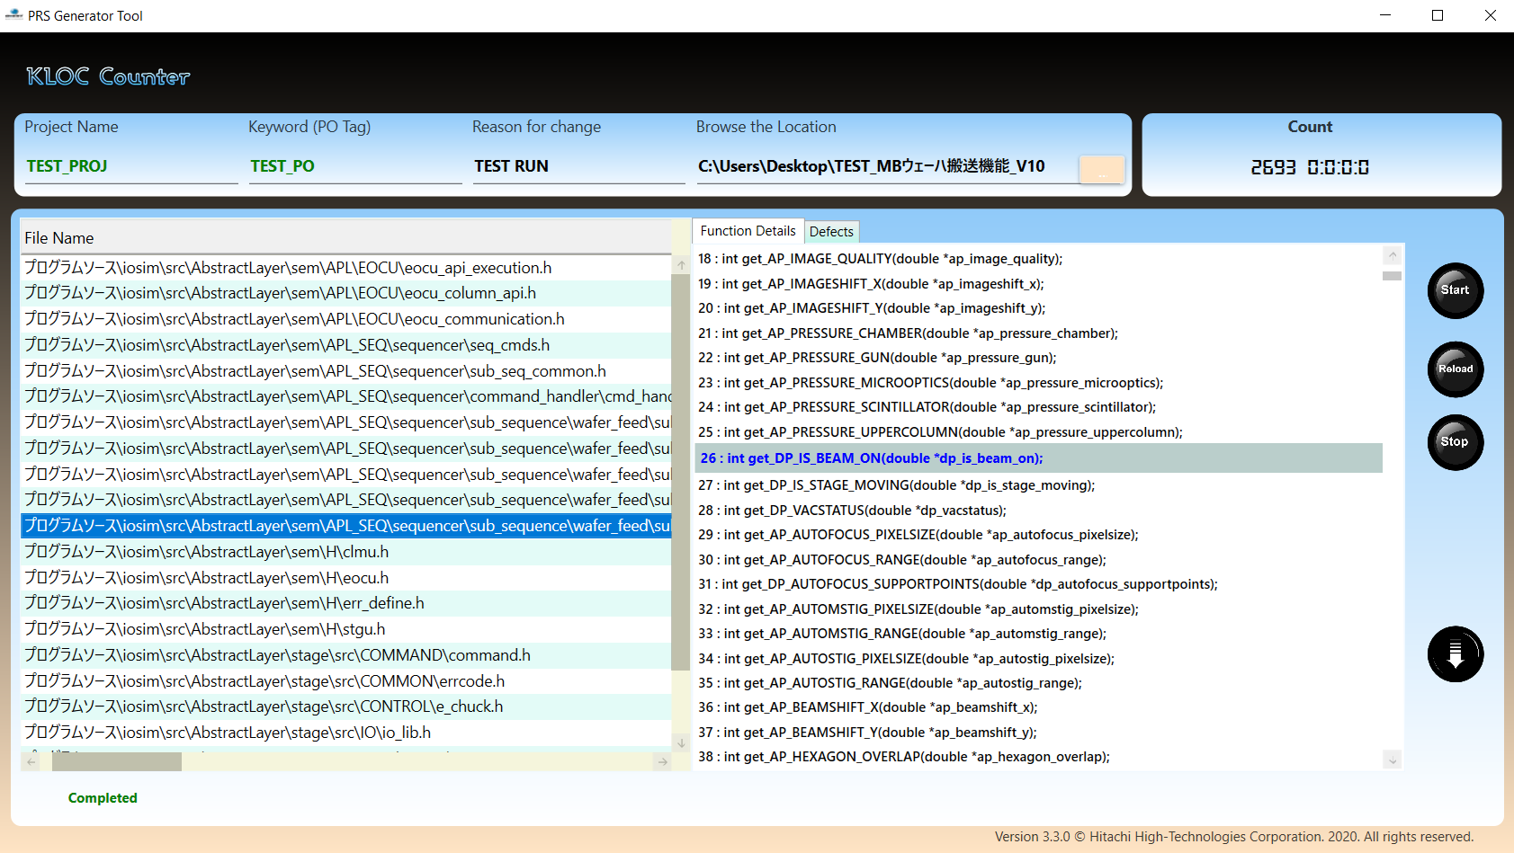
PII-8314-Auto generation of Source lines of code (KLOC Counter)
User Interface:
The user interface is divided into four sections. They are
Control area:
The user can enter inputs such as project name, PO tag, reason and location in this area.
Count area:
The LOC information displays in this area.
Task area:
The task area contains the buttons that helps to start and stop the process.
Display area:
The source file details and error notifications display in this area.
1
2
3
4

Slide 6
PII-8314-Auto generation of Source lines of code (KLOC Counter)
Components:
Component | Role
Project Name | To represents name of the Project.
PO Tag | To represents the purchase order tag. Tool, count the LOC based on this Tag
Location | To represents the Project folder path.
Display Area | To Displays all the function and LOC count details from the given folder location. The results such as Status Filename Function name Description Count (All) Count (New) Count (Mod) Count (Del)

Slide 7
PII-8314-Auto generation of Source lines of code (KLOC Counter)
Components:
Component | Role
Defect Monitor | It contains two tabs such as Function and Defects. Function tab displays the code and the Defect tab displays the error details.
Start | Start button is used to Start the LOC Count.
Download | Generates the PRS report and saved into user preferred location.
Stop | Stop button is used to kill the process.
Refresh | Refresh button is helps to clear the Display area.
Working flow:
Step 1: Enter name of the project in the “Project name” textbox.
Project name is added to the sheet name of the PRS report.
Step 2: Enter PO tag in the “Keyword” textbox.
The “PO number” in the preparation window has to be specified to get the changes in the source file.

Slide 8
PII-8314-Auto generation of Source lines of code (KLOC Counter)
Working flow:
Step 3: Select source path in the “Browse the location” text box.
The user can enter or select the location on this text box.
Step 4: Enter the change description in the “Reason for change” text box.
This field is not mandatory. It is helps to update the PRS report.
Step 5: Click the “Start” button.
This button is used to initiate the counting process.
Step 6: Click the “ ” button for generate the PRS document.
If the LOC counting process is successful, this button will become active.
After the document creation, system will prompt the user to save then document. We can select the specified location and save.

Slide 9
PII-8314-Auto generation of Source lines of code (KLOC Counter)
Effort Savings:
KLOC Counter (Version) | Effort for tool preparation and update (PD) | Effort for tool Testing (PD)
1.0.0 | 4 | 0.5
2.0.0 | 4 | 0.5
3.0.0 | 2 | 0.5
4.0.0 | 2 | 0.5
Effort for tool preparation and update : 14 days.
Projects | Effort WITHOUT tool for a single release (PD) | Current Effort WITH tool for a single release (PD) | Releases from Oct 2019 to Nov 2021 | Effort without tool (PD) | Actual effort with tool (PD)
TAS | 5.0 | 0.25 | 9 | 45 | 2.25
TMF | 8.0 | 0.25 | 7 | 56 | 1.75
Log Analyzer | 8.0 | 0.25 | 7 | 56 | 1.75
Total | 23 | 157 | 5.75

Slide 10
PII-8314-Auto generation of Source lines of code (KLOC Counter)
Effort Savings:
Effort would have taken without Tool | 157
Actual effort with Tool | 5.75
Effort for tool preparation and update | 14
Effort savings | 137.25(Days)

Slide 11
Additional references
This tool is used on a variety of projects, including TAS, TMF, Log Analyzer, Emma and HV.
Get the User manul.docx by double clicking the attachment.
Attached user manual above for more reference.

Slide 12
Thank You
Engineering | Enterprise Solutions | Operations & Supply Chain | Technology & Digital Solutions

